Slide 1


Slide 2
Our company:
A Homey place is a place or environment where you find
yourself comfortable, cozy and happy.
Homey is an organization that design, makes, and sells furniture
to customers that are looking to make their house elegant and comfortable
with new furniture.
It also provides an application to help our customers imagine the design of our furniture applied in their home, this application uses AR (augmented reality) technology.
We have also a website customer can see our furniture and buy it also.

Slide 3
About us
You can contact with us by our website or application or you can also came to our company we always here to help our customers gets there needs

Slide 4
01
Organizing
03
Controlling
Planning
Influencing
02
04
Establishing orderly for resources
Ensuring that an event accures as it was planned
What it will do and Haw achieve the Objectives
Guiding the activities of organizing member

Slide 5
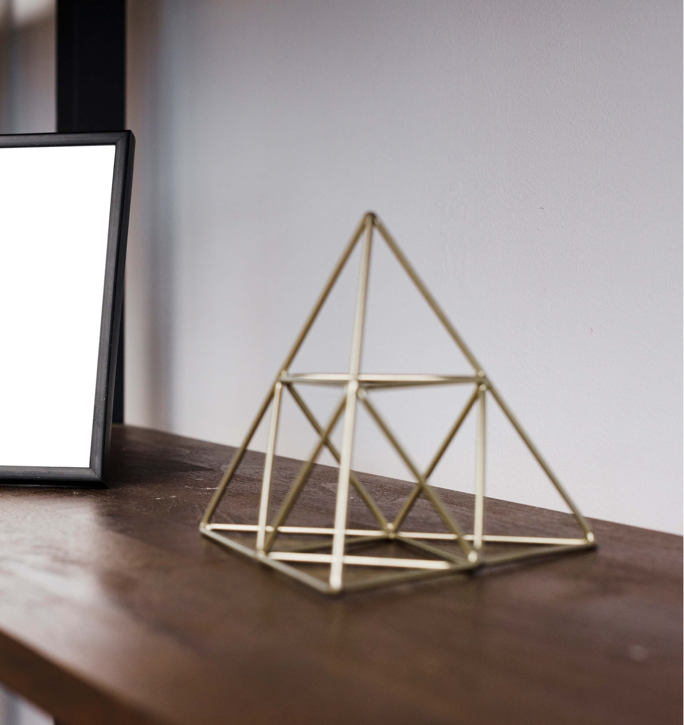
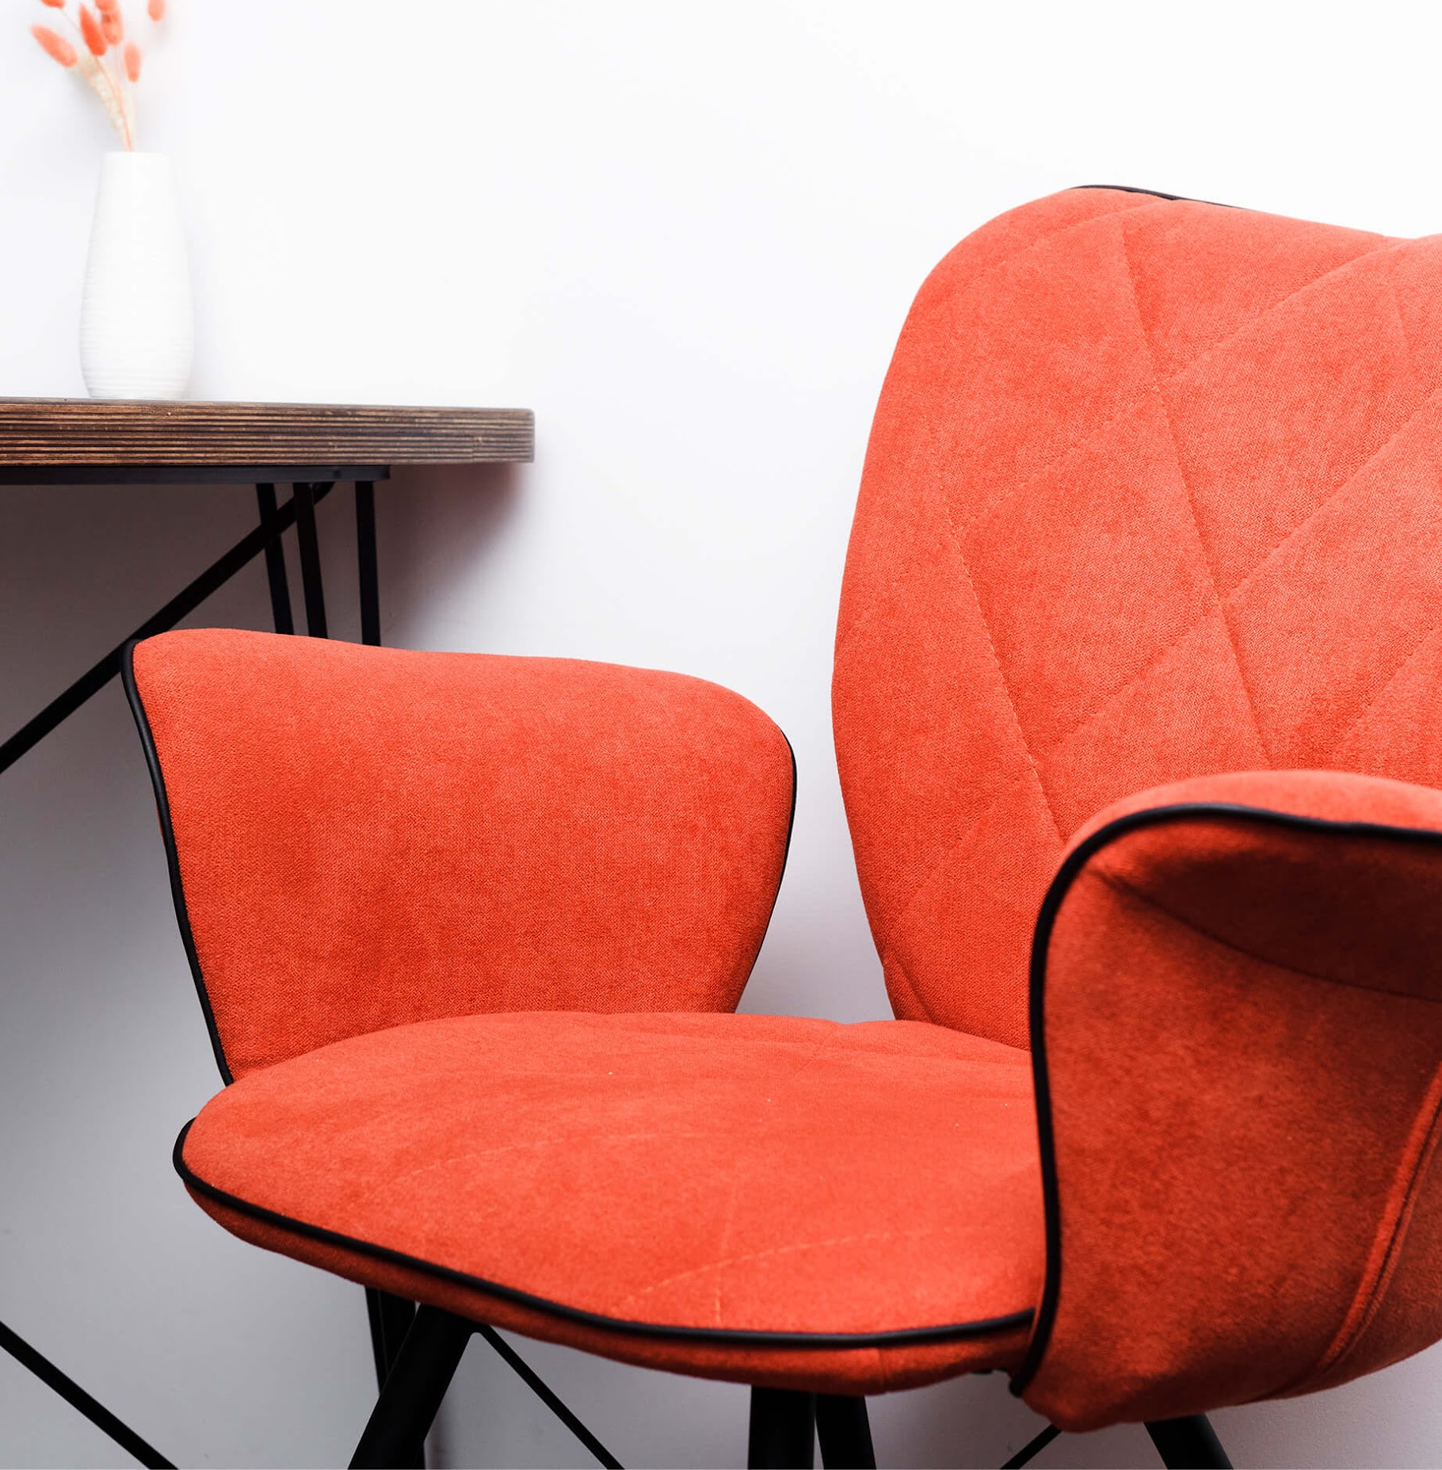
Planning
Design and make furniture. We use comfortable and high-quality materials.
Our materials are eco-friendly (we use reclaimed or recycled materials, like wood, glass and iron to create sustainable furniture).
achieve profit of 700,000 L.E. in the first five years.
Workers work 30 hours weekly.
Using social media for marketing.
Develop an innovative web site and application.
We use business Incubator.

Slide 6
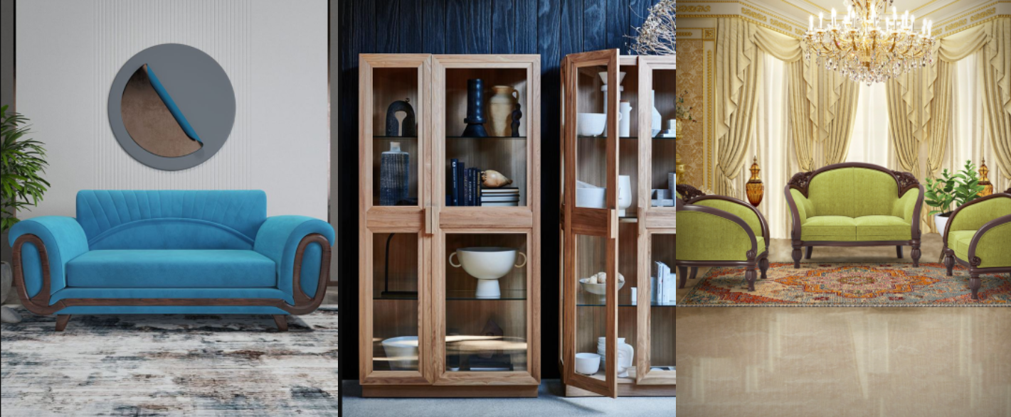
application uses AR (augmented reality) technology
provides the application to our customers imagining the design of our furniture applied in their home so that you can see your future home at the realty before buying anything

Slide 7
See your furniture in virtual reality

Slide 8
Our branches
We hope to open branches to cover every portion in Egypt and over the world to make people feel comfortable and happy

Slide 9
Organizing
CEO
Manage all the main manager and follow their work
Human Resources department:
Technical department:
Division of labor
Hire and recruit the employees
Handle computer and network mechanism.
Marketing department:
Sellers
Design and furniture department:
sell furniture and helps customers
Marketing and our Advertisement campaign
create and design our furniture.

Slide 10
01
The encoder (source)
Interpersonal communication
01
02
02
The signal
03
The decoder (destination)
03
Influencing
encodes information to be shared with others
Encoded information that the source wants to share
the person(s) with whom the source wants to share information.

Slide 11
Motivate others
Build successful teams
Emotional Intelligence that manager should have
Manage creativity and innovation
Lead others

Slide 12
Controlling
2. Measure performance
1. Comparing Performance to Standard
2. Measure performance
Employee attitudes toward work what employees accomplish
determining the magnitude of the variance
3.Tacking Corrective Action
performance falls short of expectations, corrective action the only way to rescue the company

Slide 13
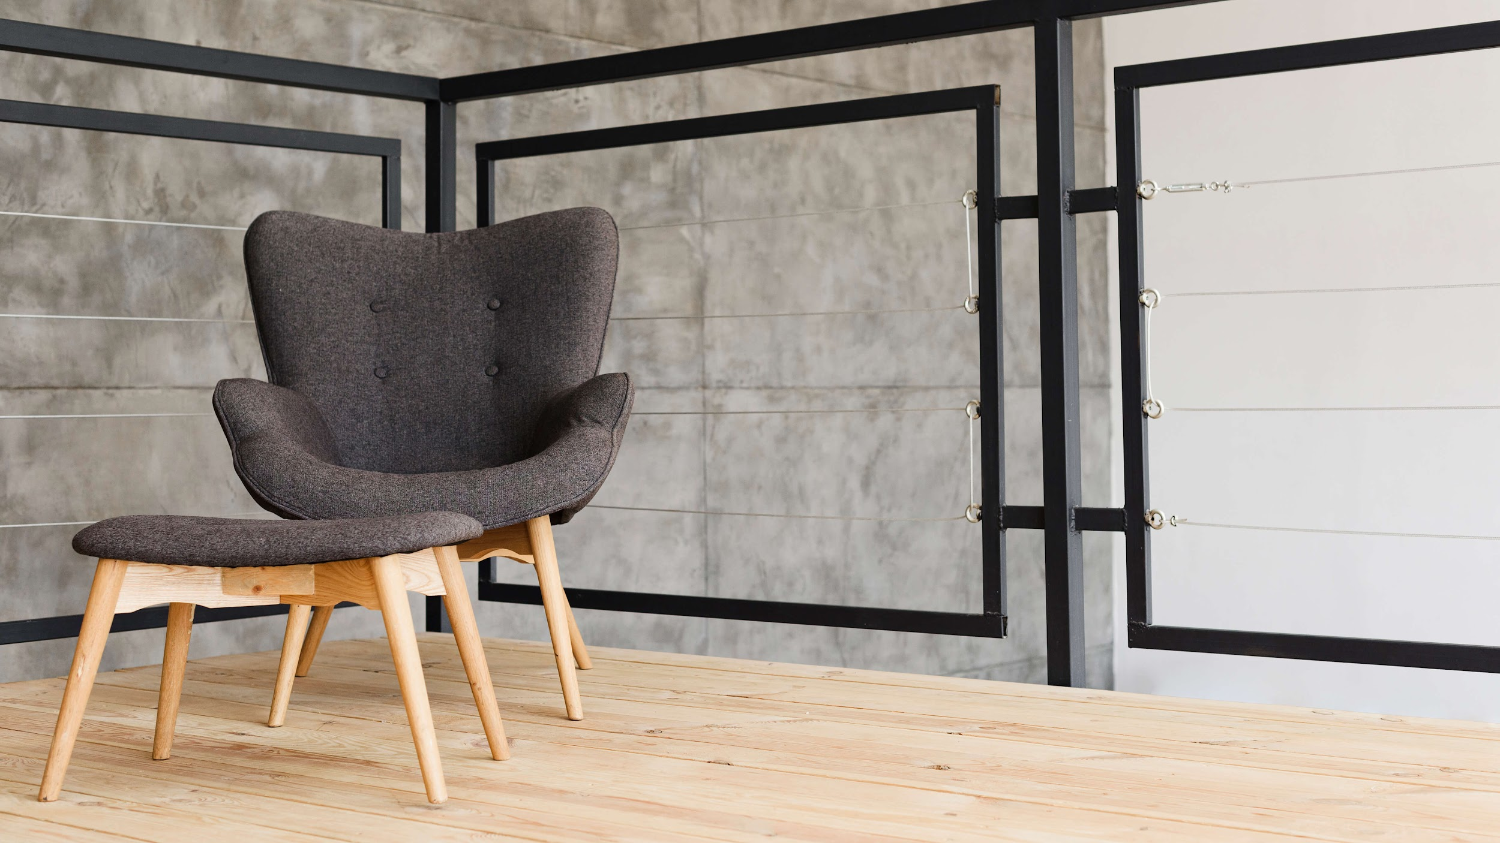
Thank You

Slide 14
Team Members

